Slide 1
HTTP STATUS CODE
A Quick Overview of
Israt Jahan Rithy
Associate Software Engineer
Cefalo Bangladesh LTD.

Slide 2
What Are HTTP Status Codes?

Slide 3
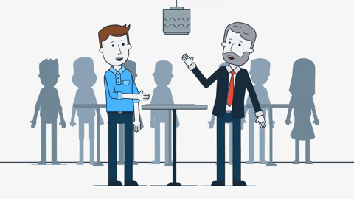
What Are HTTP Status Codes?
Two people communicating through natural language

Slide 4

What Are HTTP Status Codes?
People Communicating Through Gesture

Slide 5


Communicating
Browser
Server

Slide 6
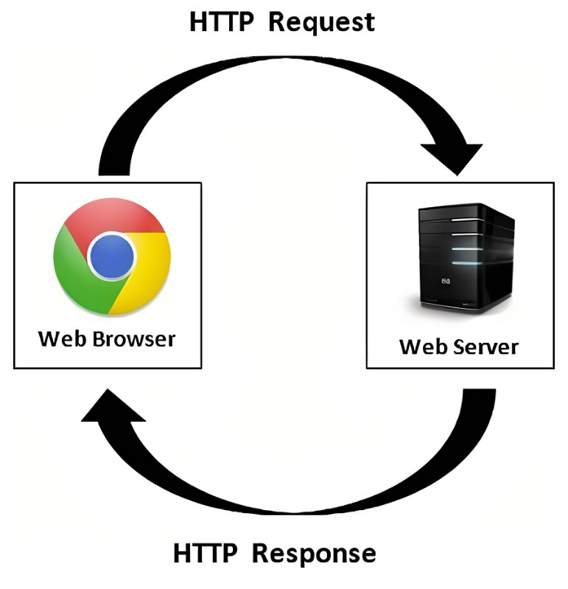
What Are HTTP Status Codes?
When you visit a website, your browser sends a request to the site’s server, and the server then responds to the browser’s request with a three-digit code: the HTTP status code.

Slide 7
Example of HTTP Status Code
User looks ( searches ) for the URL www.google.com in the browser.
Browser requests the server to get the content of www.google.com
Server gets the requests and there are no error from the Browser side or Server Side.
Thus, the server sends a response to the browser with a 200 OK status.

Slide 8
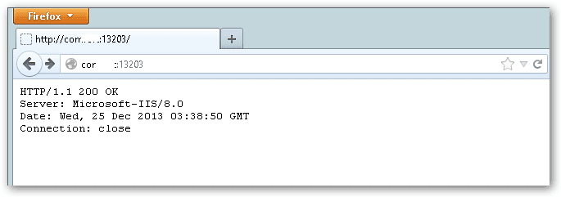
Example of HTTP Status Code

Slide 9
Why HTTP Status Codes Are Needed?

Slide 10

Why HTTP Status Codes Are Needed?
Makes the communication between browser and server optimized.
Used for Search Engine Optimization of the website.
Helps to understand the errors in server or browser.

Slide 11
HTTP Status Code Classes

Slide 12
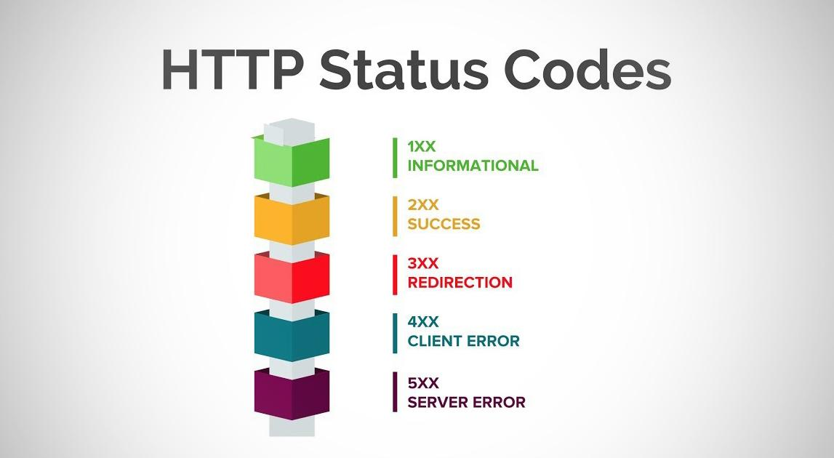
HTTP Status Code Classes

Slide 13
HTTP Status Code Classes
The Server is thinking about the request.
Not Frequently Used.
Example :
100 - Continue
101 - Switching Protocol
102 - Processing
1XX
INFORMATIONAL

Slide 14
HTTP Status Code Classes
The request was successfully completed.
The server gave the browser expected response.
Example :
200 - OK
202 - Accepted.
2XX
SUCCESS

Slide 15
HTTP Status Code Classes
The request was received.
There are some sort of redirection.
Example :
307 - Temporary Redirect.
302 - Found.
3XX
REDIRECTION

Slide 16
HTTP Status Code Classes
The requested page could not be reached.
Often appears when a page doesn’t exist on the site.
Example :
400 - Bad Request
404 - Not Found.
4XX
CLIENT ERROR

Slide 17
HTTP Status Code Classes
A valid request was made by client but there was some sort of error in server side.
Client can make same request again after a while.
Example :
500 - Internal Server Error.
5XX
SERVER ERROR

Slide 18
Frequently Used HTTP Status Codes

Slide 19

ERROR 404
Happiness NOT FOUND

Slide 20
Frequently Used HTTPS Status Codes
200 OK
200
General Status Code
The Request Has Succeeded
OK
The information returned with the response is dependent on the method used in the request

Slide 21
Frequently Used HTTPS Status Codes
201 CREATED
201
The request has been fulfilled and resulted in a new resource being created.
Response MAY contain an ETag response header field indicating the current value of the entity tag for the requested variant just created
CREATED

Slide 22
Frequently Used HTTPS Status Codes
204 NO CONTENT
The server has fulfilled the request but does not need to return an entity-body
204
The response MAY include new or updated meta information in the form of entity headers
NO CONTENT
The response MUST NOT include a message-body, and thus is always terminated by the first empty line after the header fields.

Slide 23
Frequently Used HTTPS Status Codes
304 NOT MODIFIED
304
Used for conditional GET calls to reduce bandwidth usage.
Indicates the request has not been modified since the last request.
The 304 response MUST NOT contain a message-body, and thus is always terminated by the first empty line after the header fields.
Not Modified

Slide 24
Frequently Used HTTPS Status Codes
400 BAD REQUEST
The request could not be understood by the server due to malformed syntax.
400
General error when fulfilling the request would cause an invalid state. Domain validation errors, missing data, etc. are some examples.
BAD REQUEST
The client SHOULD NOT repeat the request without modifications.

Slide 25
Frequently Used HTTPS Status Codes
401 UNAUTHORIZED
401
Error code response for missing or invalid authentication token.
The response MUST include a WWW-Authenticate header field containing a challenge applicable to the requested resource.
UNAUTHORIZED

Slide 26
Frequently Used HTTPS Status Codes
403 FORBIDDEN
403
The request was a legal request, but the server is refusing to respond to it.
Unlike a 401 Unauthorized response, authenticating will make no difference.
FORBIDDEN

Slide 27
Frequently Used HTTPS Status Codes
404 NOT FOUND
404
The server has not found anything matching the Request-URI.
This status code is commonly used when the server does not wish to reveal exactly why the request has been refused
NOT FOUND

Slide 28
Frequently Used HTTPS Status Codes
409 CONFLICT
409
Indicates that the request could not be processed because of conflict in the request, such as an edit conflict.
The response body SHOULD include enough information for the user to recognize the source of the conflict.
CONFLICT

Slide 29
Frequently Used HTTPS Status Codes
410 GONE
410
Indicates that the resource requested is no longer available and will not be available again.
GONE
This should be used when a resource has been intentionally removed and the resource should be purged.

Slide 30
Frequently Used HTTPS Status Codes
500 INTERNAL SERVER ERROR
500
The server encountered an unexpected condition which prevented it from fulfilling the request.
The general catch-all error when the server-side throws an exception.
INTERNAL SERVER ERROR

Slide 31
Facts About HTTP Status Codes

Slide 32
Fact - 1

Slide 33

WHY 304 Not Modified is A Redirectional Status Code?

Slide 34



Conditional Request
Redirects ( If condition fulfilled)
Server
Returns updated content with 200 OK status code
Browser
Local Cache

Slide 35
Fact - 2

Slide 36
Why do we need a different code for an almost same thing?
404 Not Found Represents the entered URL does not exists.
410 Gone
Represents the entered URL no longer exists.

Slide 37
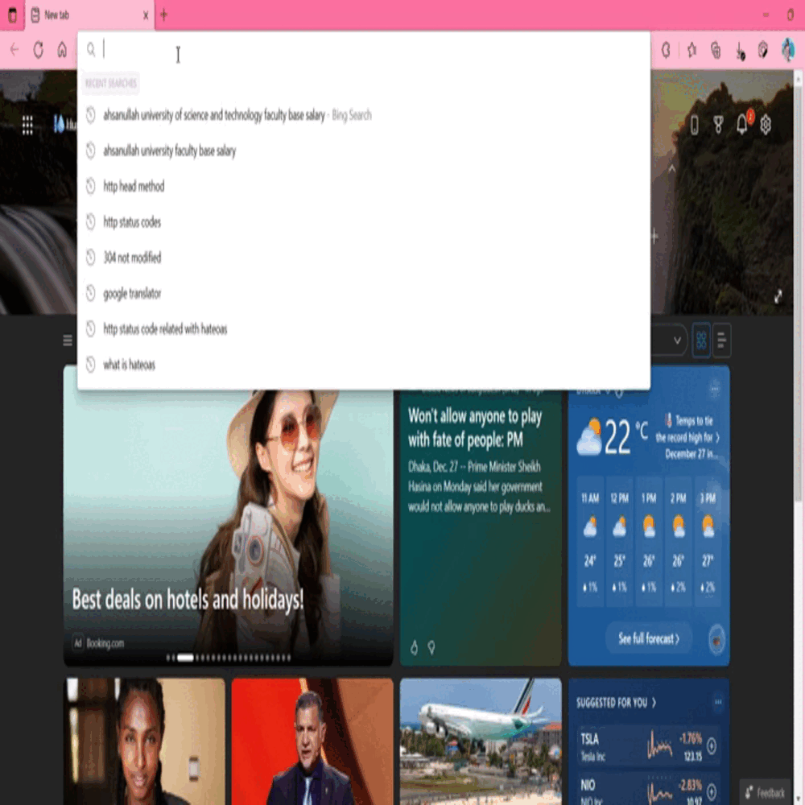

Slide 38

User Satisfaction Matters!

Slide 39

Different Client Error Codes Help in Case of Search Engine Optimization.

Slide 40
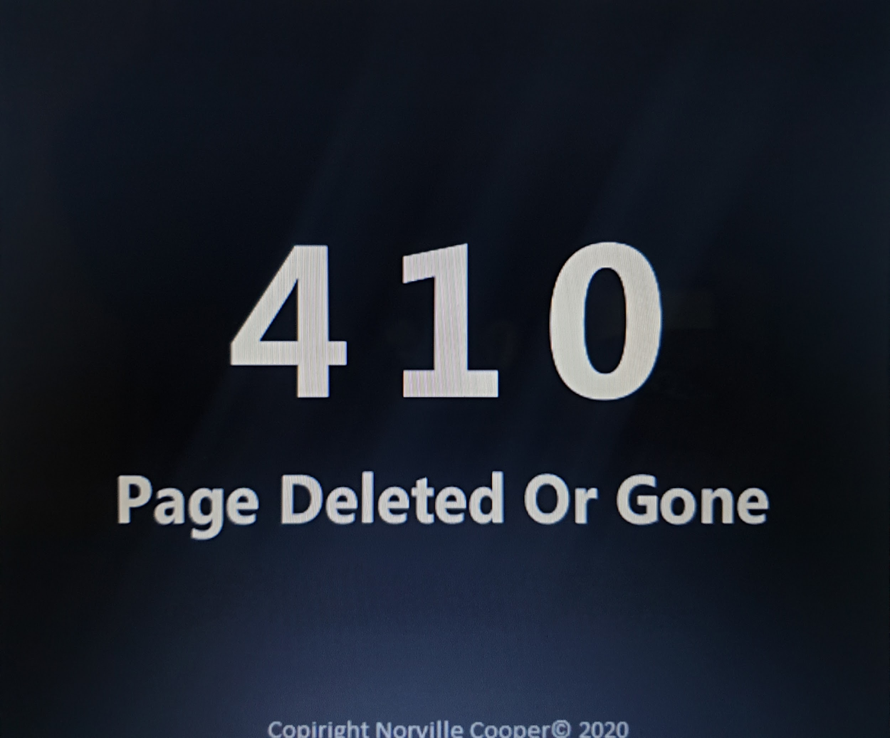
Helps search engine to remove the URL from search results.
Makes the user experience smoother.

Slide 41
Confusion Between Status Codes

Slide 42
Scenario 1

Slide 43
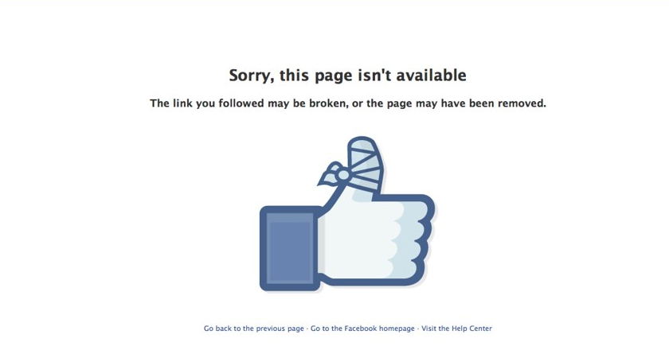
Which error message should be sent in case of
Facebook account deactivation and deletion?

Slide 44


Deactivated means the profile is temporarily hidden. It may get back anytime.
Delete means the profile is deleted forever. It can not be restored any more.

Slide 45

DEACTIVATION
DELETION
404
410
NOT FOUND
GONE

Slide 46
Scenario 2

Slide 47
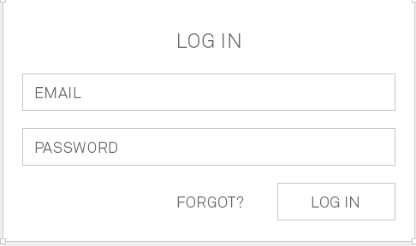
What should be the response code in case user does not enter the credentials?

Slide 48
Correct
401
UNAUTHORIZED

Slide 49
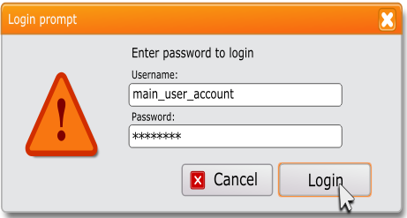
What should be the response code in case user enters wrong credentials?

Slide 50
Correct
401
UNAUTHORIZED
User should be presented the entity that was given in the response.

Slide 51
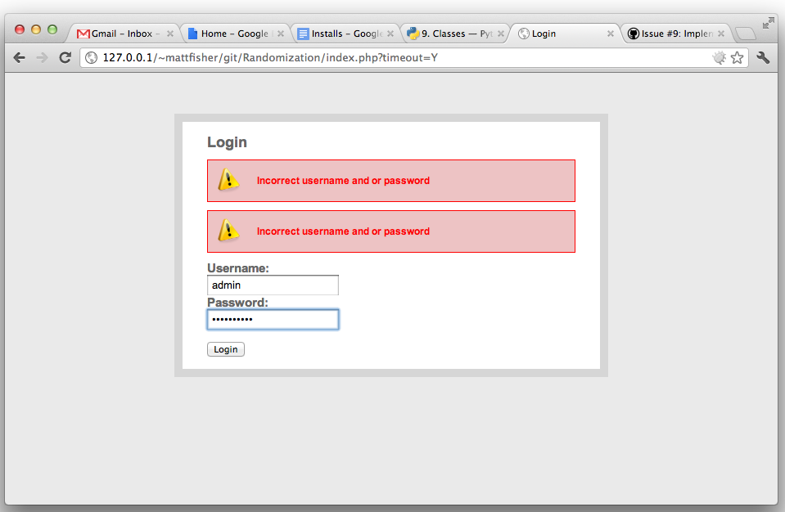
Relevant Response

Slide 52
Scenario 3

Slide 53
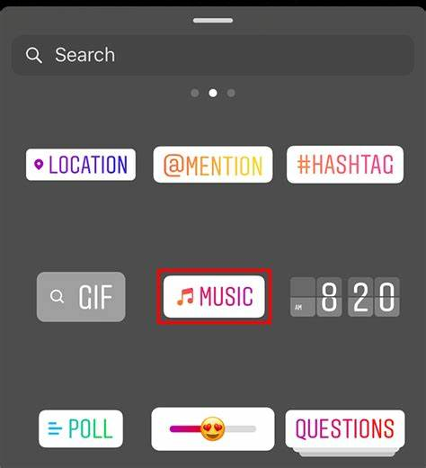

Which status code should be returned here?

Slide 54
Correct
403
FORBIDDEN

Slide 55
Scenario 4

Slide 56
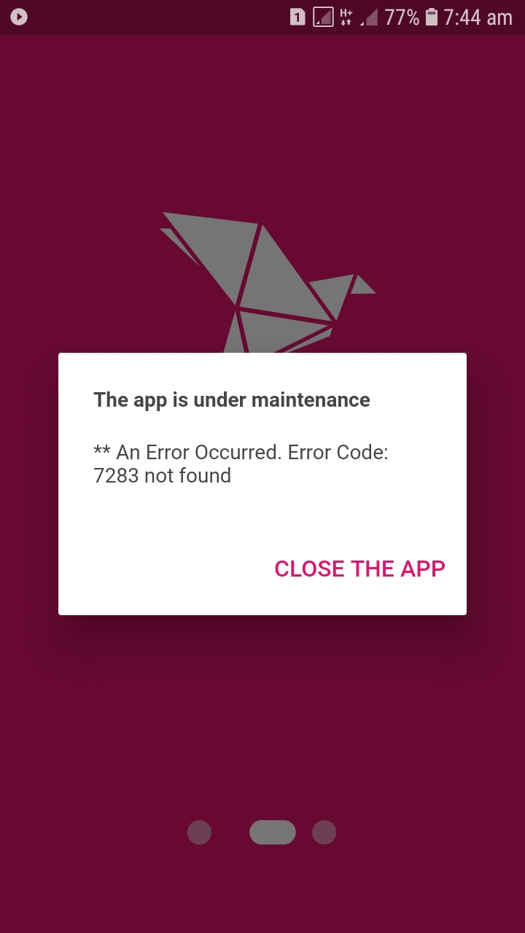
Correct User ID
Correct Password
App Access Denied Due to Maintenance
Usable through *247#

Slide 57

Should Not be Sent
Should be Sent
500
403
Server Error
FORBIDDEN

Slide 58
Scenario 5

Slide 59

What if we want to hide the actual error reason to the user?

Slide 60

To prevent Brute force attack server may not wish to let the client know about authentication refusal.

Slide 61
Can be used.
404
NOT FOUND

Slide 62
Scenario 6

Slide 63

User entered a URL that does not exist in the server.
docs.facebook.com

Slide 64

400
BAD REQUEST
500
Internal Server Error

Slide 65
No error in server.
Server Received the request.
The request was not understood by the server.
User should not repeat the request again.
400
BAD REQUEST

Slide 66
Scenario 7

Slide 67

Sending a big POST request.
The header arrived at server.
Due to traffic http body not arrived yet.
Server checked the header.
The header had no error.
What response should be returned?

Slide 68


201
100
Created
Continue

Slide 69

Saves time and bandwidth usage in case of errored header.

Slide 70
Sending a big POST request.
Server received the whole request.
Due to server traffic the server could not make the change yet.
It will fulfill the request once the queue is over.
What response should be returned?

Slide 71
202
100
Accepted
Continue

Slide 72
Scenario 8

Slide 73
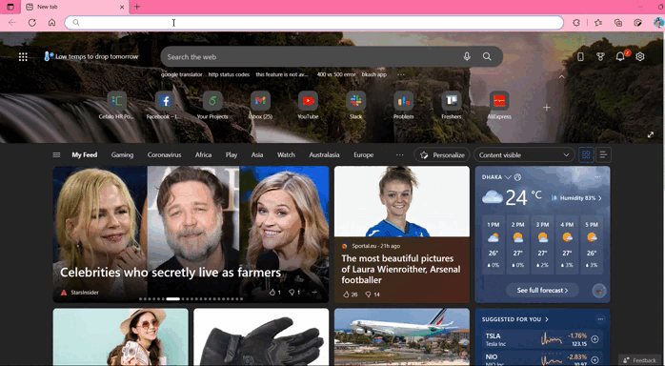

Slide 74

Facebook bought the fb.com domain and redirected www.facebook.com url to this domain.

Slide 75
301
307
Moved Permanently
Temporary Redirect

Slide 76

It is not necessary that we will always create a new website and redirect it to an older URL.

Slide 77
Scenario 9

Slide 78

204
No Content
Edit password feature of an website

Slide 79

Why not 200 OK or 201 Created?

Slide 80

No new resource created.
No need to update the current page.
Optimized transfer.

Slide 81

200
OK
Edit Username

Slide 82
Confusion Between
302
307
Found
Temporary Redirect

Slide 83

NOT AGAIN!!

Slide 84

302 and 307 both can be used when content has temporarily been moved, and will be back in the near future.

Slide 85


302 Always Redirects using GET method
307 Always Redirects the same method
Google Ignores The Difference

Slide 86

That’s All for
Today!

Slide 87
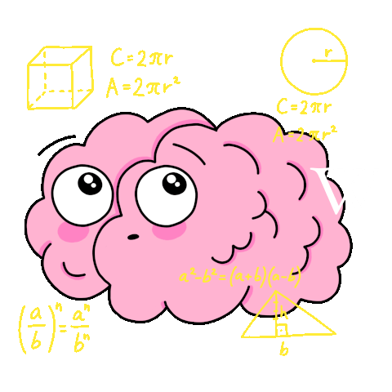
Thank You
Any Questions?

Slide 88
References
www.google.com
https://developer.mozilla.org/en-US
https://www.geeksforgeeks.org/which-http-response-status-codes-result-in-then-and-which-in-catch/?ref=rp
https://www.getcredo.com/404-vs-410-which-status-code-should-you-use/
https://www.restapitutorial.com/httpstatuscodes.html
www.facebook.com
https://stackoverflow.com/
https://en.wikipedia.org/wiki/List_of_HTTP_status_codes
https://www.tutorialspoint.com/http/http_status_codes.htm
https://www.javatpoint.com/http-status-codes

